Slide 1

STUDENT ATHLETE’S NIL DEALS
Emmanuel Erhirhie
ECON 83200

Slide 2
INTRODUCTION
NIL" stands for "Name, Image, and Likeness," and refers to a new policy in college sports that allows student-athletes to profit from their own name, image, and likeness. NIL deals are the agreements that student-athletes make with companies or individuals who wish to use their name, image, or likeness in exchange for compensation. These deals can take many forms, including social media endorsements, product promotions, and appearances in advertisements.

Slide 3
PURPOSE
The purpose of this web scrapping is to gather data to show us student athletes getting NIL deals which has shown a test of good faith in which students devote their whole life to sport and get paid for their hard work..

Slide 4
METHODOLOGY
The project was done using VS CODE notebook where I downloaded python, and libraries like LXML, Beautifulsoup4, Pandas and Request.
I started the project by using beautiful soup to scrap the website picking an HTLM link that easy for me to extract the data where I later used htlm.parlay instead of lxml in order for the link be easily read by python. Then further went to use ‘Request’ to collect the data from the website, which was stored in a data frame called ‘Pandas’ which was cleaned and was later exported to as csv file that shows a table of all the athletes with their NIL deals, the school they play for and their social media accounts.

Slide 5
EXPERIENCE AND CHALLENGES
Watching YouTube videos made it look easy because the website they were scrapping from was easy, less complex and straightforward. Which was my major challenge because the website I was scrapping was very complicated, had a lot of data and layers upon layers upon layers of html, getting the right html was hard it took me weeks to get the html that would give me the precise data I want.
Lastly joining the table was hard. I had to study my data and do some research on how to join data from different pages of the website.

Slide 6
LINKS FOR REASEARCH
https://medium.com/geekculture/web-scraping-tables-in-python-using-beautiful-soup-8bbc31c5803e
https://www.projectpro.io/recipes/scrape-table-from-webpage-beautiful-soup
https://medium.com/analytics-vidhya/webscraping-a-site-with-pagination-using-beautifulsoup-fa0a09804445

Slide 7
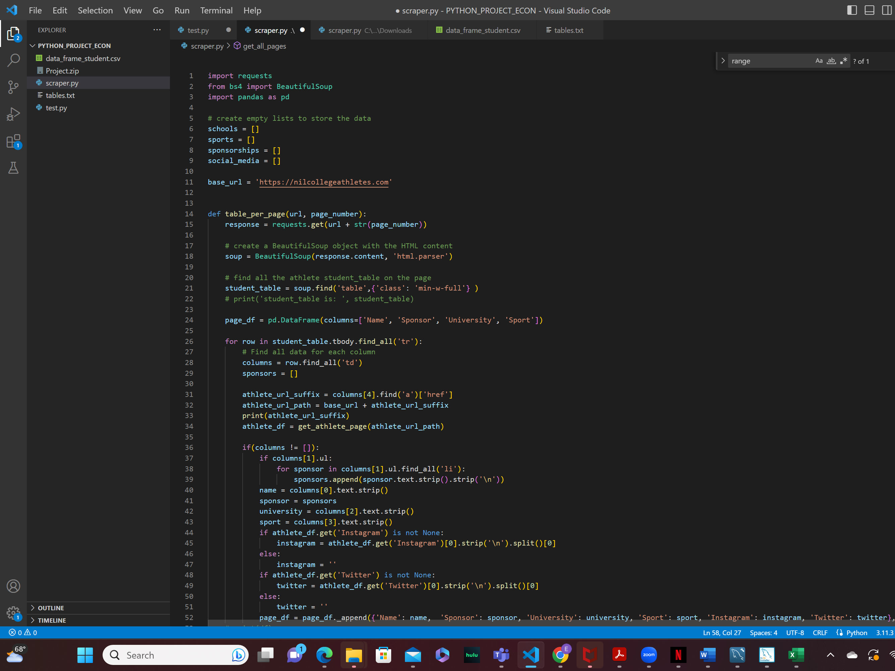
PYTHON CODE

Slide 8
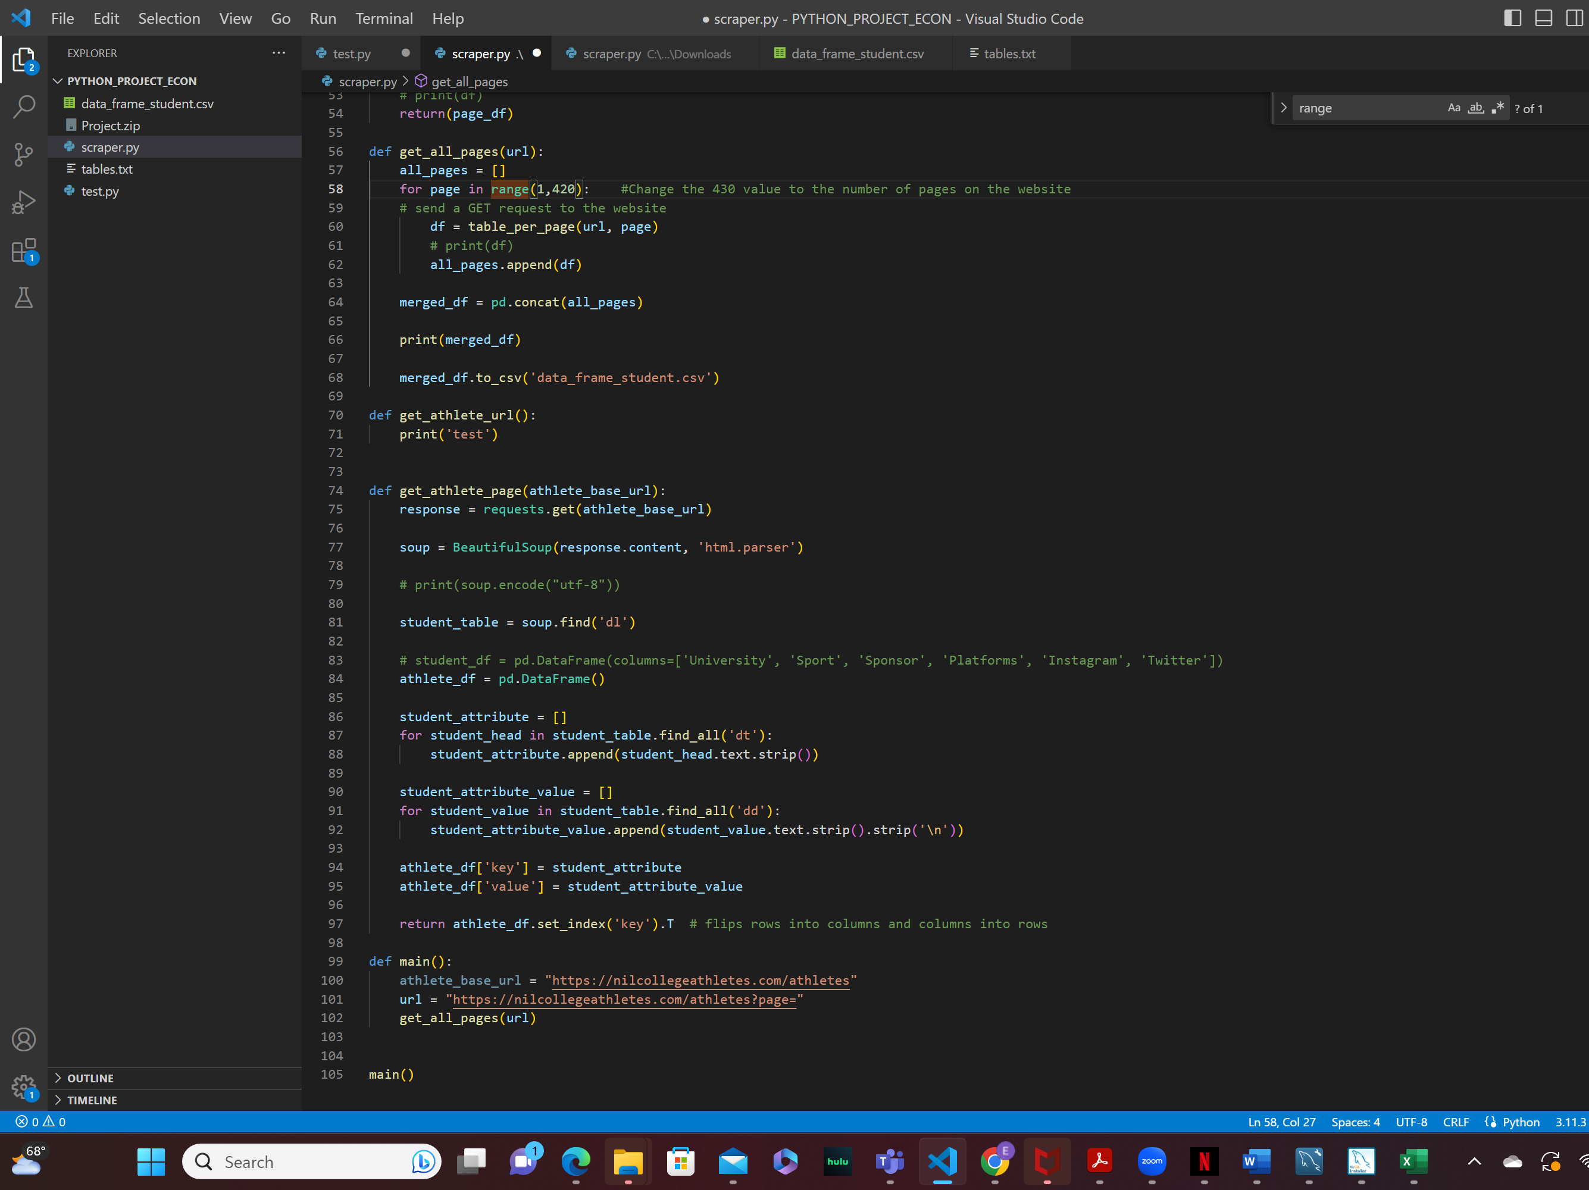
PYTHON CODE

